Slide 1

The Fading American Dream: Upward Mobility by Birth Cohort
Percent of Children Earning More than Their Parents, by Year of Birth
92% of children out-earned their parents in 1940
79%
62%
61%
Today, only 48% of children will.
50%
Child's Year of Birth
1940
1950
1960
1970
1980
1990
Source: Chetty, Grusky, Hell, Hendren, Manduca, Narang (Science 2017)

Slide 2
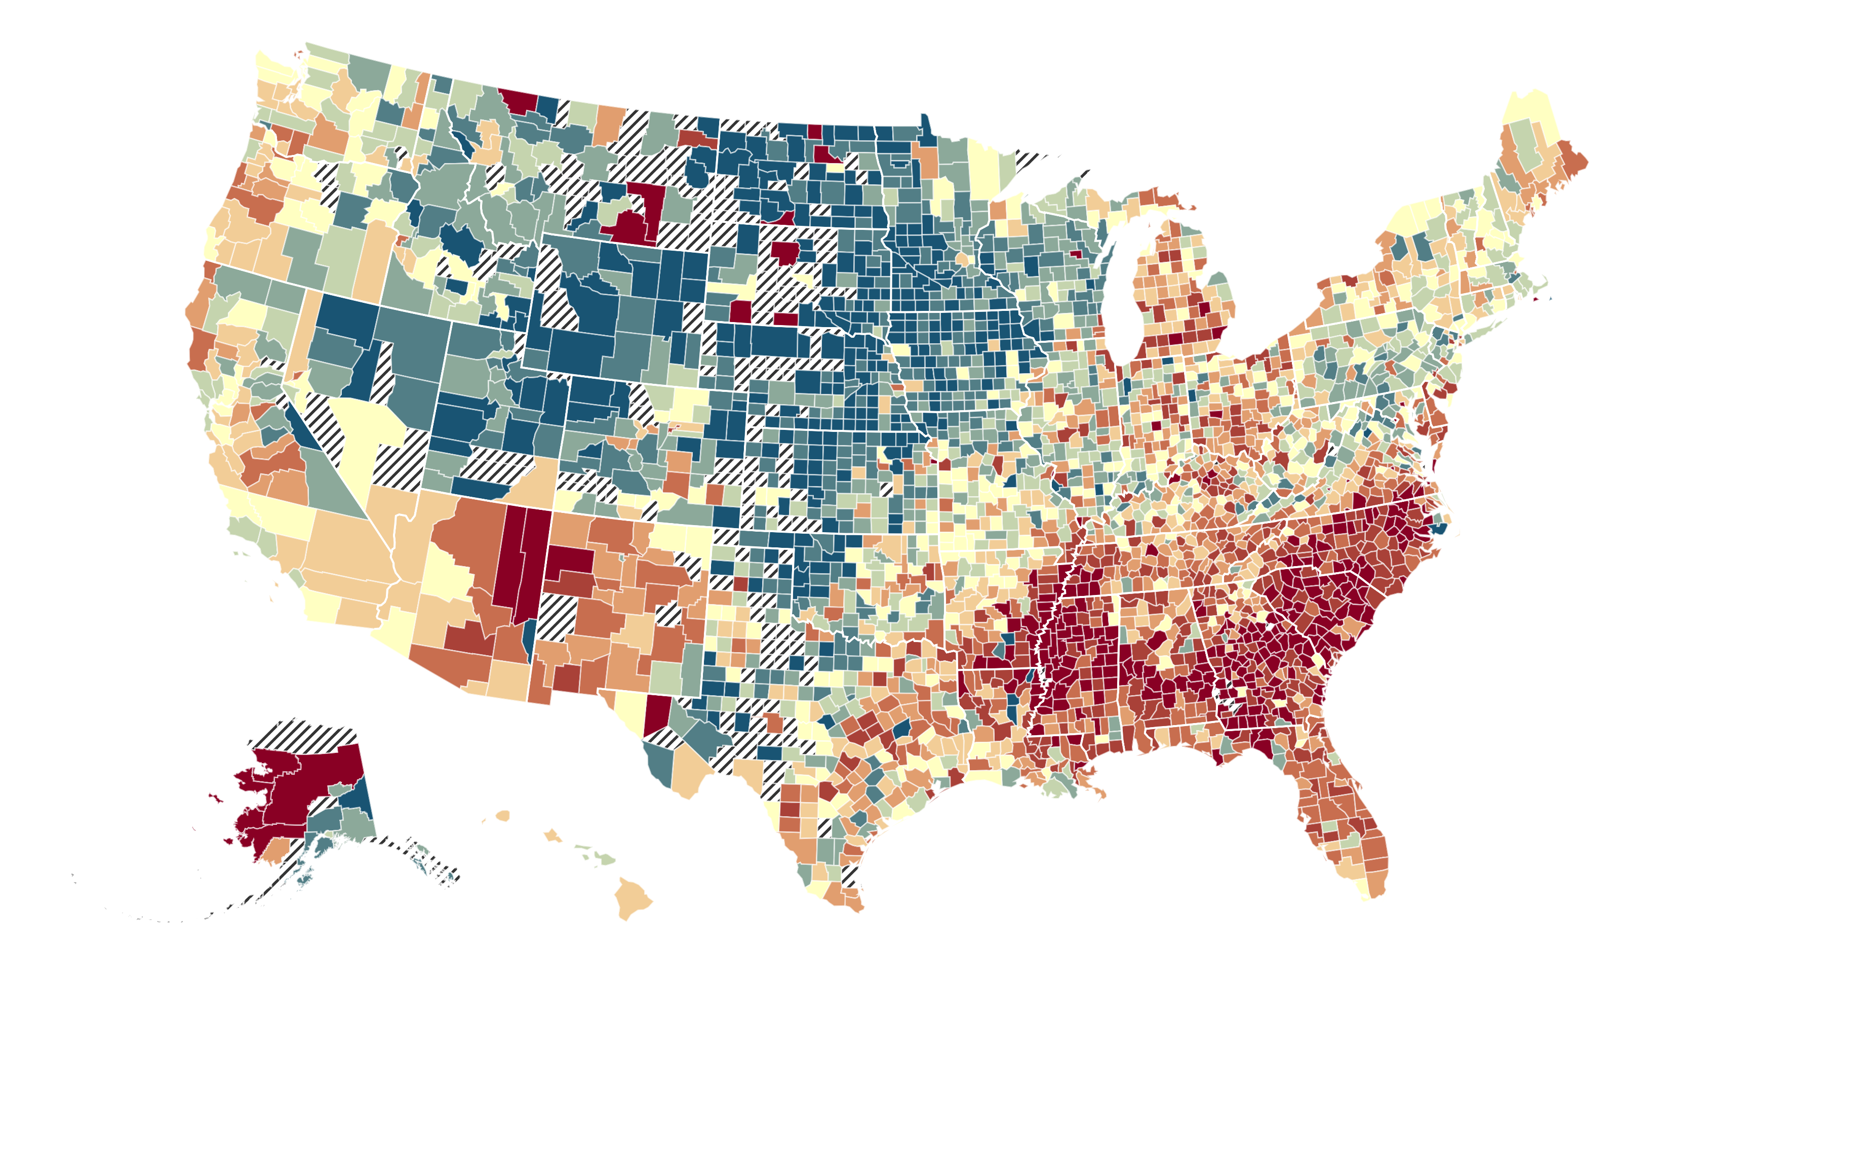

The Geography of Upward Mobility in the United States, by County
Average Household Income at Age 35 for Children Born in 1978 whose Parents Earned $41K (25th percentile)
Dubuque
$68K
Columbus
$42K
Pittsburgh
$54K
Portland
$50K
Las Vegas
$45K
Philadelphia
$47K
Baltimore
$42K
Charlotte
$39K
Atlanta
$41K
New Orleans
$44K
<$30k
$50k
>$83k
Tulsa
$48K
Austin
$47K
Blue = More Upward Mobility
Red = Less Upward Mobility
Source: Chetty, Hendren, Kline, Saez (QJE 2014)

Slide 3
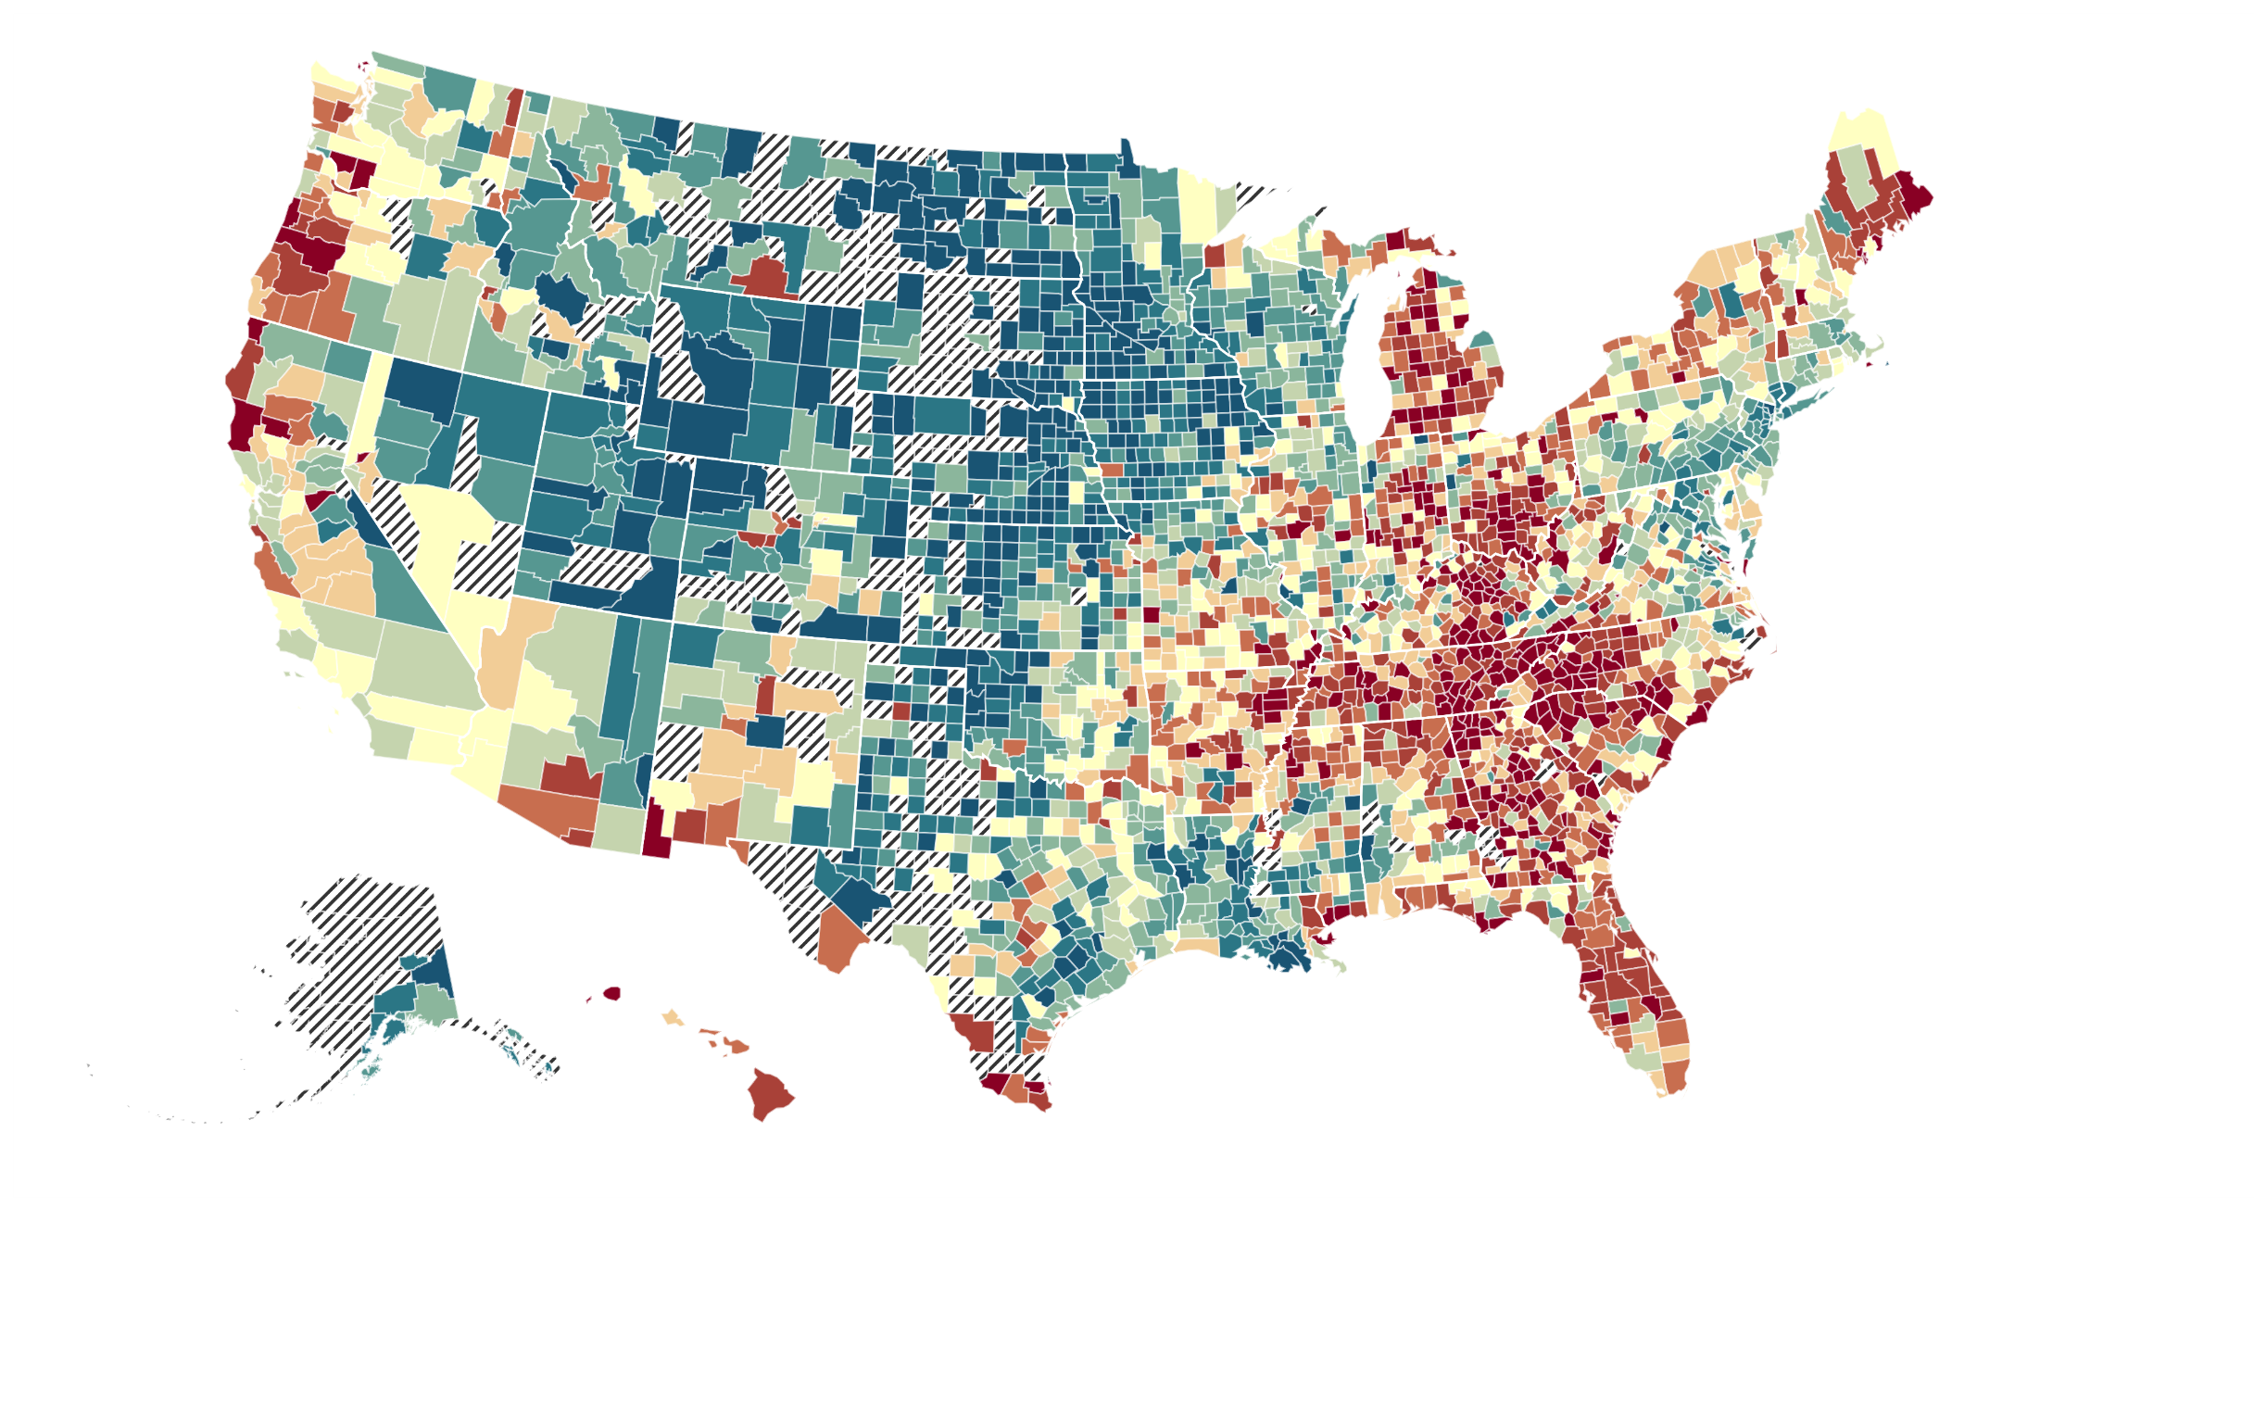
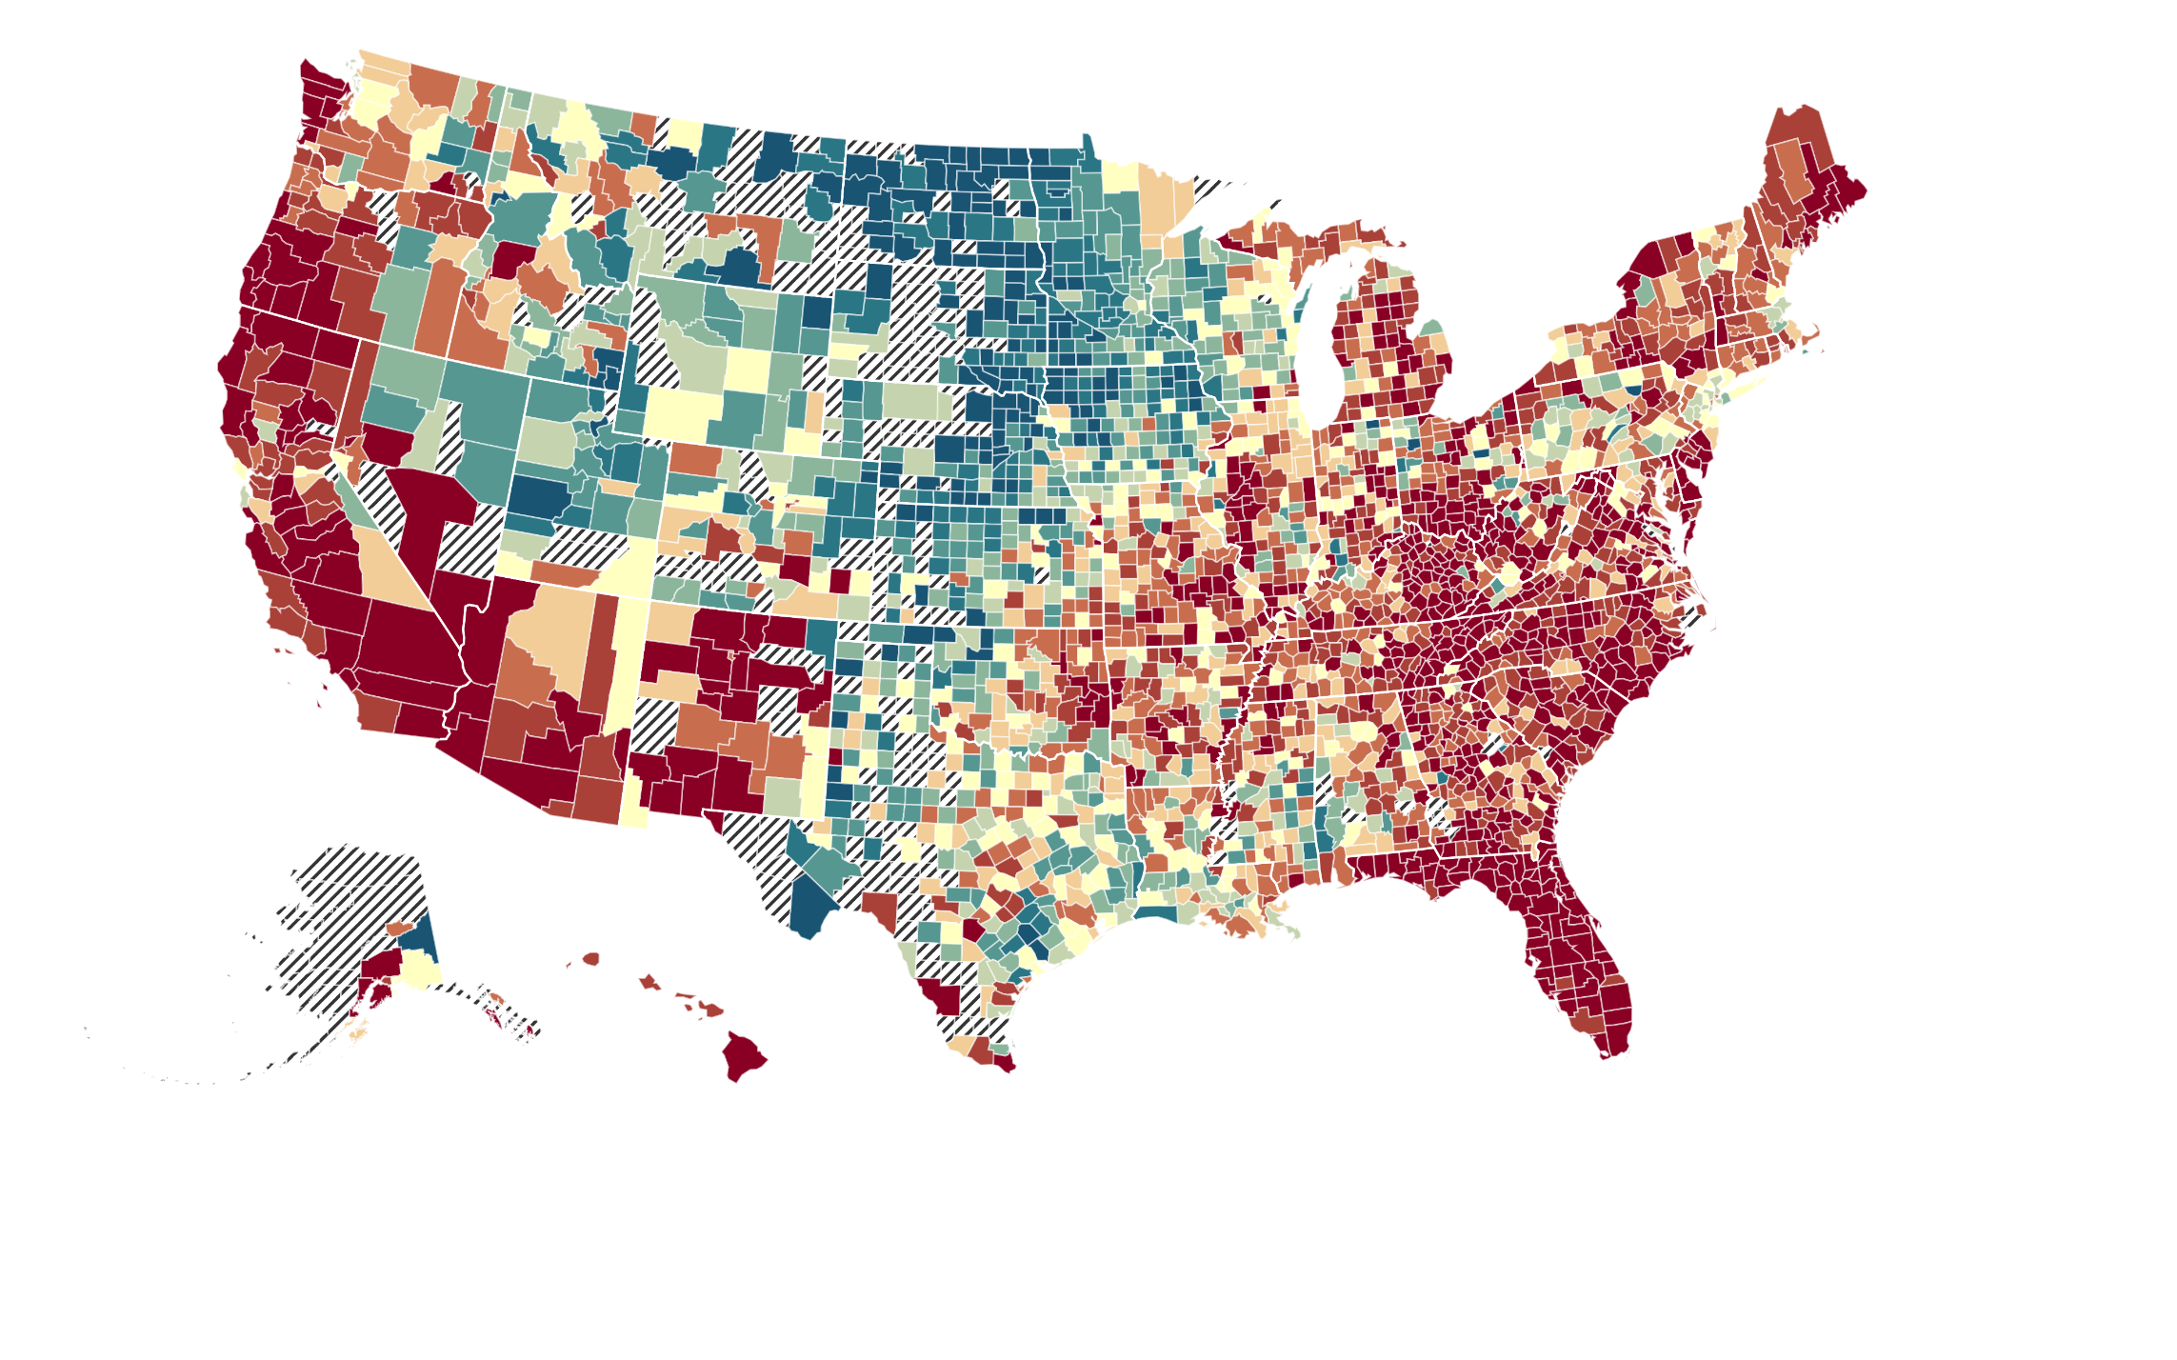
Changes in Opportunity for White Americans
White Children with Low-Income Parents
Born in 1978
Born in 1992
Household Income Percentile at Age 27 for Children with Parents at 25th Percentile
$30.8k
$33.7k
$40.9k
Notes:
Winston-Salem CZ: -4.4% change (HH income)
- Individual income: -0.8% change

Slide 4
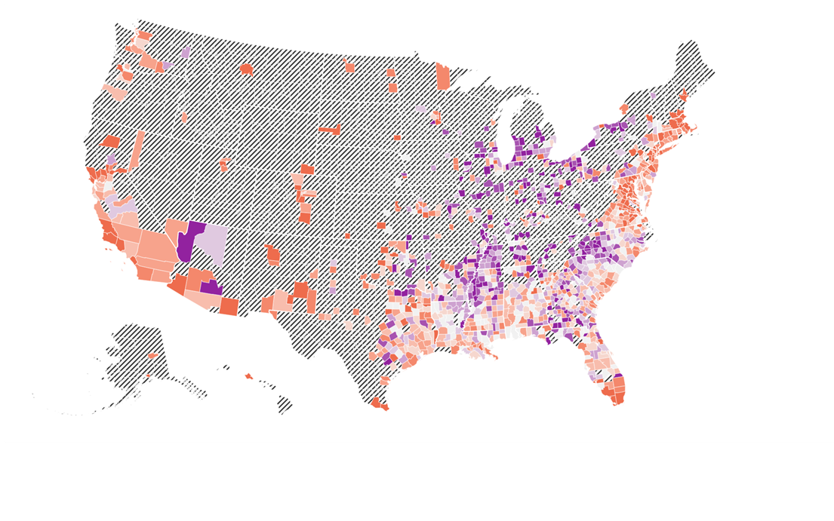
Changes in Opportunity for Black Americans
Black Children with Low-Income Parents
Born in 1978
Born in 1992
Household Income Percentile at Age 27 for Children with Parents at 25th Percentile
$18.8k
$21.2k
$25.6k

Slide 5
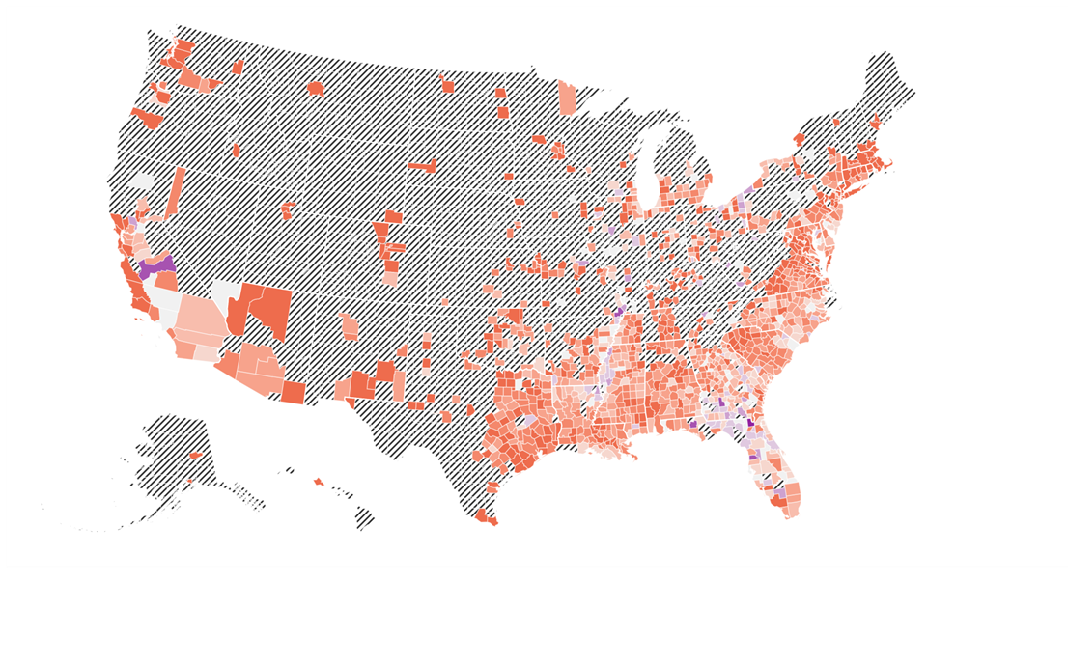
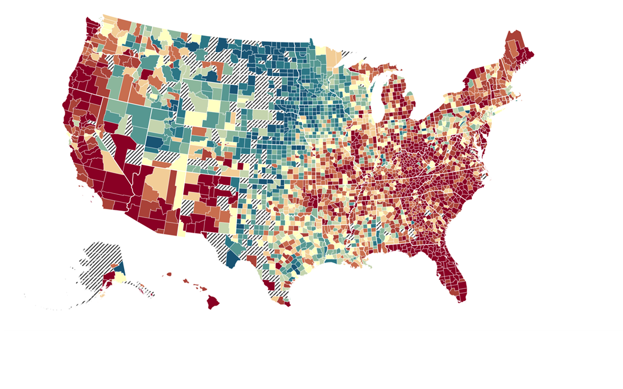
The Geography of Upward Mobility in the United States
Average Household Income at Age 27 for Children born in 1992 whose Parents Earned $27K
Black Children Born in 1992
White Children Born in 1992
Household Income Percentile at Age 27 for Children with Parents at 25th Percentile
$18.8k
$21.2k
$25.6k
$30.8k
$33.7k
$40.9k

Slide 6
Changes in Upward Mobility in the United States
Average Change in Household Income at Age 27 for Children born in 1978 vs. 1992 to Low-Income Parents
Source: Chetty, Dobbie, Goldman, Porter, Yang (2024)
Notes:
Highlight geography of audience

Slide 7
Changes in Mobility for Black vs. White Children with Low-Income Parents
$6k
$4k
Forsyth County
$2k
Change in Avg. Household Income for
Black Children from Low-Income Families
0
-$2k
-$6k
-$4k
-$2k
0
Change in Avg. Household Income for White Children from Low-Income Families
Notes:
Customize to where you’re presenting if possible (if dot fits on these axes)

Slide 8
Trends in Economic Mobility by Group in Forsyth County
Change in Children’s Income in Adulthood born to Low-Income Parents, 1978 vs. 1992 Birth Cohorts
Born in 1978
Born in 1992
$29.8K
$31.4K
White
$24.7K
$31.0K
Hispanic
$18.9K
$22.1K
Black
$31.3K
$35.0K
Asian
$12.1K
$25.1K
American Indian
$25.7K
$26.3K
All
Source: Opportunity Atlas, Opportunity Insights and the US Census Bureau
Notes:
Customize to where you’re presenting if possible

Slide 9
Changes in Economic Mobility vs. Changes in Parent Employment Rates
By County, Race, and Class
$4k
$2k
Change in Avg. Household Income for Children in Adulthood (1978-1992 Cohorts)
$0
-$2k
White, Low-Income Parents
-$4k
-15
-10
-5
0
5
Change in County-Level Parent Employment Rate (1978-1992 Cohorts)
Source: Chetty, Dobbie, Goldman, Porter, Yang (2024)
Notes:
Fraction of Employed Parents in Baton Rouge (CZ) decreased from 67% to 61% b/w 1978 and 1998 for p25.
Labor Force participation rates (2013-2017 ACS Estimates)
Total average: 68.5% (slightly lower than state average of 72.4)
Ascension Parish: 80.4%
East Baton Rouge: 77.7%
East Feliciana: 53.4%
Iberville: 62%
Livingston: 75.5%
Pointe Coupee: 74.1%
St. Helena: 65.4%
West Baton Rouge: 75.6%
West Feliciana: 52.8%

Slide 10
Changes in Economic Mobility vs. Changes in Parent Employment Rates
By County, Race, and Class
$4k
$2k
Change in Avg. Household Income for Children in Adulthood (1978-1992 Cohorts)
$0
-$2k
White, Low-Income Parents
Black, Low-Income Parents
-$4k
-15
-10
-5
0
5
Change in County-Level Parent Employment Rate (1978-1992 Cohorts)
Source: Chetty, Dobbie, Goldman, Porter, Yang (2024)

Slide 11
Changes in Economic Mobility vs. Changes in Parent Employment Rates
By County, Race, and Class
$4k
$2k
Change in Avg. Household Income for Children in Adulthood (1978-1992 Cohorts)
$0
-$2k
White, Low-Income Parents
Black, Low-Income Parents
-$4k
-15
-10
-5
0
5
Change in County-Level Parent Employment Rate (1978-1992 Cohorts)
Source: Chetty, Dobbie, Goldman, Porter, Yang (2024)

Slide 12
Changes in Economic Mobility vs. Changes in Parent Employment Rates
By County, Race, and Class for Children whose Own Parents Remain Employed
$5k
-$2.5k
$0
Change in Avg. Household Income for Children in Adulthood (1978-1992 Cohorts)
-$2.5k
White, Low-Income Parents
Black, Low-Income Parents
-$5k
-15
-10
-5
0
5
Change in County-Level Parent Employment Rate (1978-1992 Cohorts)
Source: Chetty, Dobbie, Goldman, Porter, Yang (2024)

Slide 13
Effect of Changes in Parental Employment Rates Across Cohorts
30
Impact of Peer Parent
Employment Rate
$600
24
Share of Friends
$480
(Facebook data)
18
$360
Impact of Change in Cohort-Specific Parent
Employment on Child’s Avg. Household Income
Percent of High School Friends in Cohort
12
$240
6
$120
0
$0
4 yrs older
2 yrs older
Same Grade
2 yrs younger
4 yrs younger
Relative Birth Cohort
Source: Chetty, Dobbie, Goldman, Porter, Yang (2024)
Notes:
Notes on conversion: To convert the coefficients on parental employment to $ amounts on the second y-axis, we scale the coefficients by the p75-p25 range of change in par emp (6.11pp) divided by 10, and then multiply by $1000.
The p75-p25 range is computed by residualizing changes in par emp (for white and Black p25 kids) on race FE and then taking the difference between the 75th and 25th percentile values of this (residuals) distribution. We divide this difference by 10 as the coefficients on this plot had been scaled to show the change in income percentile for a 10pp change in par emp.
This gives us the gap between changes in par emp in places which saw above average changes and those which saw below average changes. We then multiply this gap by $1000 (which is the average width of 1 rank from p30-p70).
Example, the own cohort coefficient of 0.9 percentiles is scaled as follows: 0.9*0.6*1000

